Slide 1
Applied Statistics, Probability theory and mathematical statistics
István Fazekas, Attila Barta, Sándor Pecsora
Classical probability space
”This work was supported by the construction EFOP-3.4.3-16-2016-00021. The project was supported by the European Union, co-financed by the European Social Fund.”

Slide 2
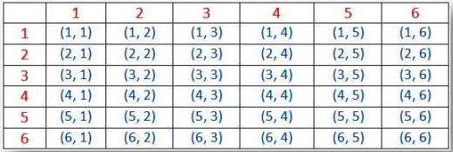

Exercise 3.1
Two fair dice are thrown. Find the probability that the sum of the numbers obtained is 8. Illustrate the sample space and the set of favorable events.
$$P\left(A\right)=\frac{5}{36}$$
Hint:
6 | 7 | 8 | 9 | 10 | 11 | 12
5 | 6 | 7 | 8 | 9 | 10 | 11
4 | 5 | 6 | 7 | 8 | 9 | 10
3 | 4 | 5 | 6 | 7 | 8 | 9
2 | 3 | 4 | 5 | 6 | 7 | 8
1 | 2 | 3 | 4 | 5 | 6 | 7
 | 1 | 2 | 3 | 4 | 5 | 6

Slide 3

Exercise 3.3
A fair die is thrown twice. Find the probability that the result of the first throw is greater than the result of the second.
Hint:
$$P\left(A\right)=\frac{15}{36}$$
Result of the first throw
Sum of the two throws
6 | 7 | 8 | 9 | 10 | 11 | 12
5 | 6 | 7 | 8 | 9 | 10 | 11
4 | 5 | 6 | 7 | 8 | 9 | 10
3 | 4 | 5 | 6 | 7 | 8 | 9
2 | 3 | 4 | 5 | 6 | 7 | 8
1 | 2 | 3 | 4 | 5 | 6 | 7
 | 1 | 2 | 3 | 4 | 5 | 6
Result of the second throw

Slide 4

Exercise 3.7
Ten people, 5 women and 5 men are sitting around a round table. Find the probability, that neither two women nor two men are sitting next to each other.
$$P\left(A\right)=\frac{4!5!}{9!}=\frac{1}{126}$$

Slide 5

Exercise 3.9
From a deck of cards three cards are dealt. Find the probability that there isn't any spade among them.
$$P\left(A\right)=\frac{C_{39}^{3}}{C_{52}^{3}}$$

Slide 6




Exercise 3.11
In an urn we have three red balls. Find the minimal number of white balls to be added to have the probability of choosing a white ball be greater than 0.9.
$$At least 28 balls$$
Hint:
$$P\left(white\right)=0$$
$$P\left(white\right)=\frac{1}{4}$$
$$P\left(white\right)=\frac{2}{5}$$

Slide 7




Exercise 3.14
In an urn we have 20 red and 30 white balls. 10 balls are chosen without replacement. Find the probability that
all the chosen balls are red.
4 red, 6 white.
at least one red.
$$P\left(A\right)=\frac{C_{20}^{10}}{C_{50}^{10}}$$
$$P\left(A\right)= \frac{C_{20}^{4}C_{30}^{6}}{C_{50}^{10}}$$
$$P\left(A\right)=1−\frac{C_{30}^{10}}{C_{50}^{10}}$$
Solve the previous exercise (question b)under the assumption that the balls are chosen with replacement.
$${P\left(A\right)=C}_{10}^{4}⋅\frac{{20}^{4}⋅{30}^{6}}{{50}^{10}}$$

Slide 8
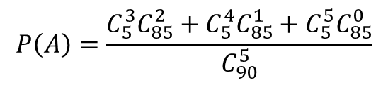
Exercise 3.17
Find the probability that on the lottery 5 from 90 we hit at least three winning numbers.
$$P\left(A\right)=\frac{C_{5}^{3}C_{85}^{2}+C_{5}^{4}C_{85}^{1}+C_{5}^{5}C_{85}^{0}}{C_{90}^{5}}$$

Slide 9

Exercise 4.1
On a rectangular target with sides of 1-meter lengths each a circle is drawn with a radius of 0.5 meter. Find the probability that a random shot (given it hits the target) hits the target outside the circle.
$$P\left(A\right)=1−\frac{π}{4}$$
Hint:
r=0.5m
?m

Slide 10

Exercise 4.2
A stick of length one meter is randomly broken into two parts. What is the probability that from the obtained parts and from a new stick of half a meter length a triangle can be formed?
$$P\left(A\right)=\frac{1}{2}$$

Slide 11
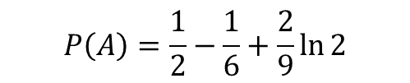

Exercise 4.6
Choose randomly two positive numbers that are less than 1. What is the probability that their sum is less than 1 and their product is less than $\frac{2}{9}$?
$$P\left(A\right)=\frac{1}{2}−\frac{1}{6}+\frac{2}{9}\ln{2}$$

Slide 12

Exercise 4.8
In 24 hours, time two ships arrive independently into the harbour of Chewbakka Bay, denoted by A and B, respectively. Ship A can be unloaded in an hour, while ship B in two hours. Workers start to unload a ship immediately after it's arrival and if the other ship arrives before they finish it has to wait. What is the probability that none of the ships has to wait?
$$P\left(A\right)=\frac{{22}^{2}+{23}^{2}}{2⋅{24}^{2}}$$

Slide 13


Exercise 4.10
Two points are chosen randomly from the interval (0, a). What is the probability that the sum of thei squares is greater than $a^{2}$?
$$P\left(A\right)=1−\frac{π}{4}$$

Slide 14
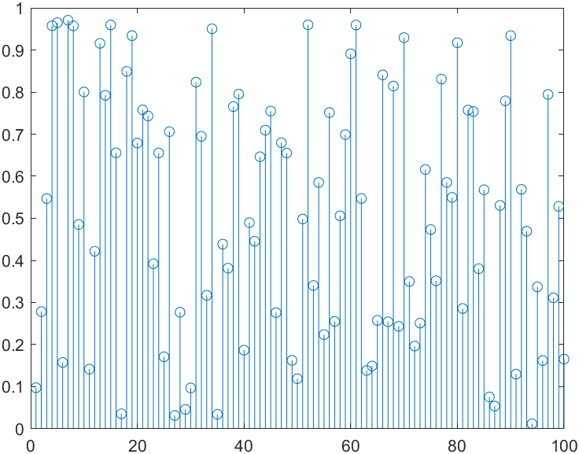
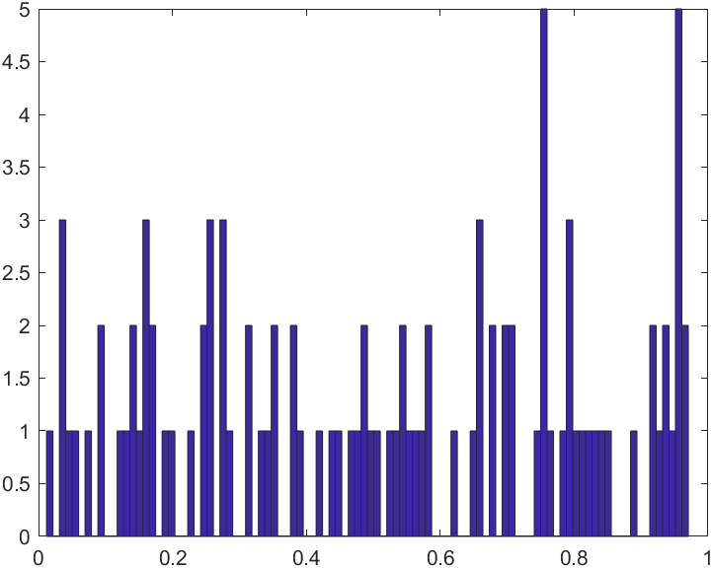
Random Numbers
x=rand(100,1);
stem(x);
hist(x,100)

Slide 15
Coin Tosses
Simulate the outcomes of 100 fair coin tosses
x=rand(100,1);
p=sum(x<0.5)/100
p =
0.5400
Simulate the outcomes of 1000 fair coin tosses
x=rand(1000,1);
p=sum(x<0.5)/1000
p =
0.5110

Slide 16
Coin Tosses
Simulate the outcomes of 1000 biased coin tosses with p[Head]=0.4
x=rand(1000,1);
p=sum(x<0.4)/1000
p =
0.4160

Slide 17
Sum of Two Dice
Simulate 10000 observations of the sum of two fair dice

Slide 18
Sum of Two Dice
Simulate 10000 observations of the sum of two fair dice
x1=floor(6*rand(10000,1)+1);
x2=floor(6*rand(10000,1)+1);
y=x1+x2;
sum(y==2)/10000 ans = 0.0275 p[2]=0.0278
sum(y==3)/10000 ans = 0.0554 p[3]=0.0556
sum(y==4)/10000 ans = 0.0841 p[4]=0.0833
sum(y==5)/10000 ans = 0.1082 p[5]=0.1111
sum(y==6)/10000 ans = 0.1397 p[6]=0.1389
sum(y==7)/10000 ans = 0.1705 p[7]=0.1667
sum(y==8)/10000 ans = 0.1407 p[8]=0.1389
sum(y==9)/10000 ans = 0.1095 p[9]=0.1111
sum(y==10)/10000 ans = 0.0794 p[10]=0.0833
sum(y==11)/10000 ans = 0.0585 p[11]=0.0556
sum(y==12)/10000 ans = 0.0265 p[12]=0.0278

Slide 19
Sum of Two Dice
Simulate 10000 observations of the sum of two fair dice
clf;
ISM=10000;
d1=randi(6,1,ISM);d2=randi(6,1,ISM);
[count, bin]=hist(d1+d2,2:12);
bar(bin, count/ISM)

Slide 20
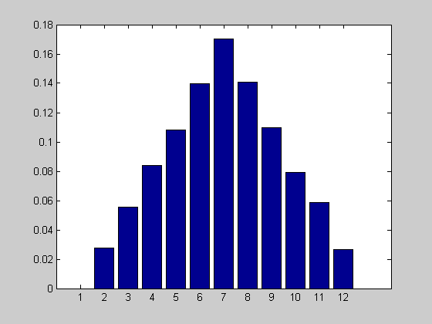
Sum of Two Dice
for i=2:12
z(i)=sum(y==i)/10000
end
bar(z)

Slide 21
Literature
Ágnes Baran: Mathematics for engineers 1. (Laboratory slides)
Sándor Baran: Probability theory and statistics
Fazekas István: Valószínűségszámítás, Debreceni Egyetemi Kiadó, 2009
Fazekas István: Bevezetés a matematikai statisztikába, Debreceni Egyetemi Kiadó, 2009
Matlab examples: https://www.mathworks.com/help/examples.html

